Slide 1
21W24#008 Surface Figure Images
12-27-12

Slide 2
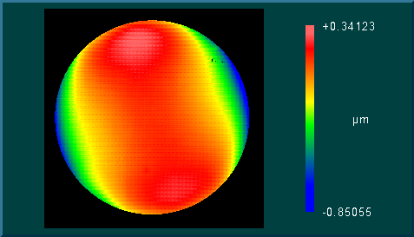
Unpowered Surface Figure
PV: 1.192um
RMS: 0.202um

Slide 3
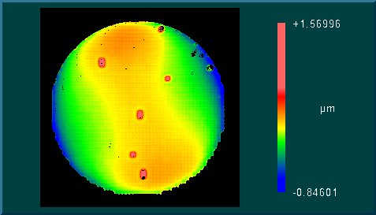
Max. Pull Down, 181V

Slide 4
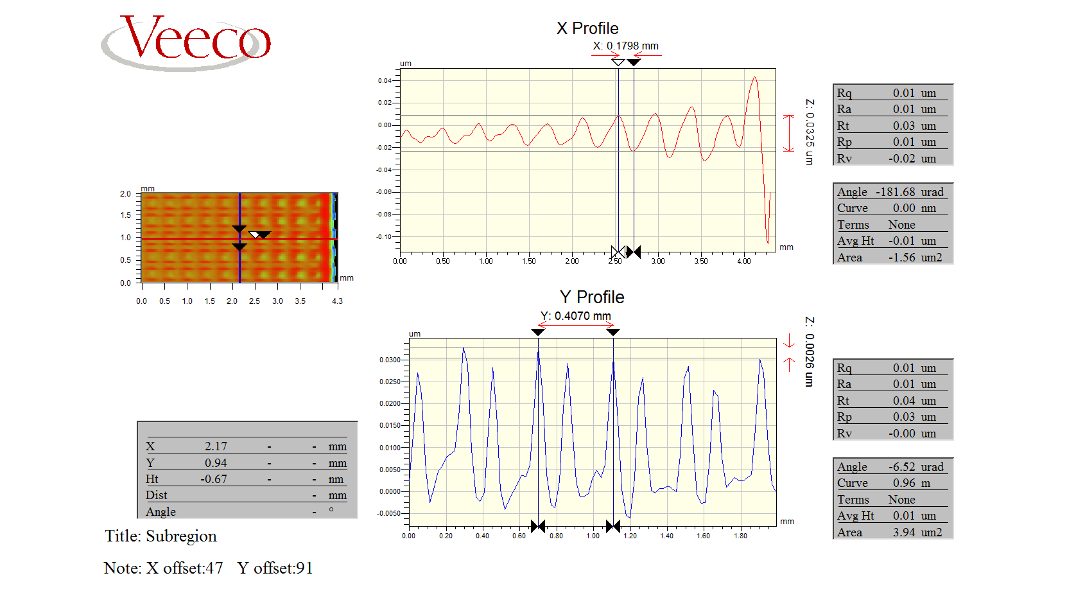
Scalloping , 33nm

Slide 5
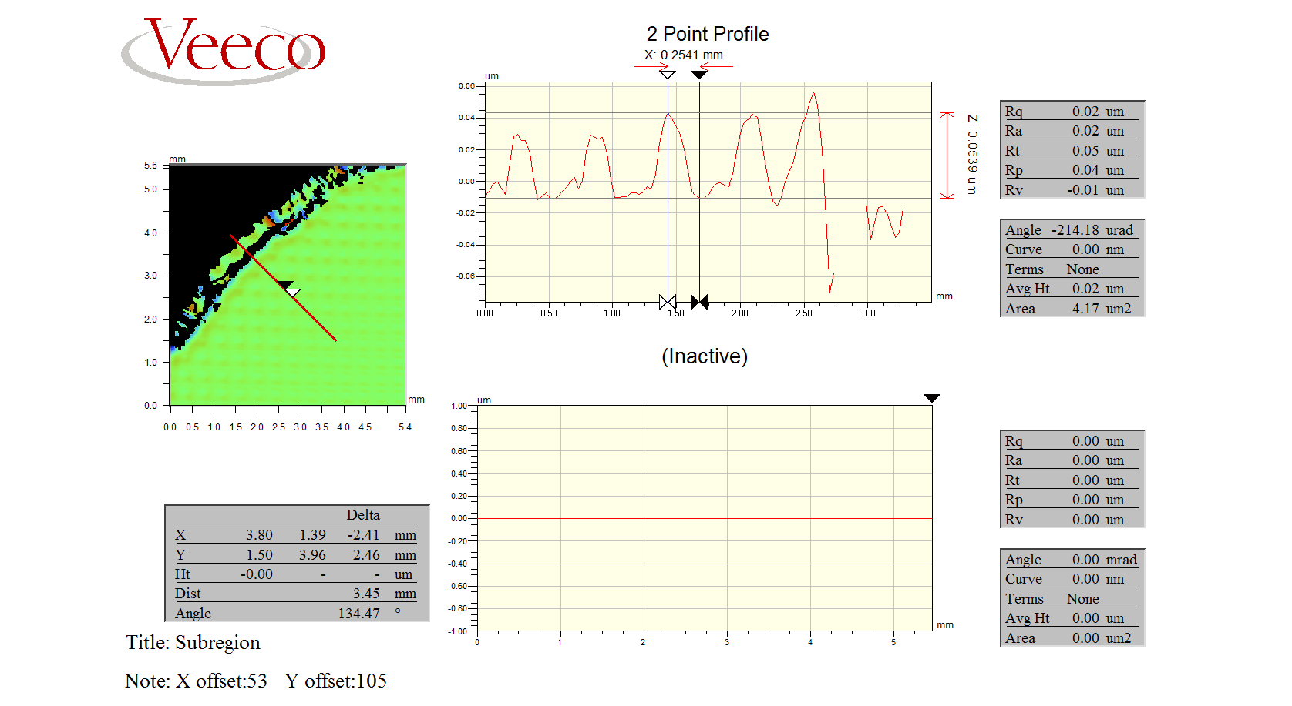
Scalloping, 54nm

Slide 6
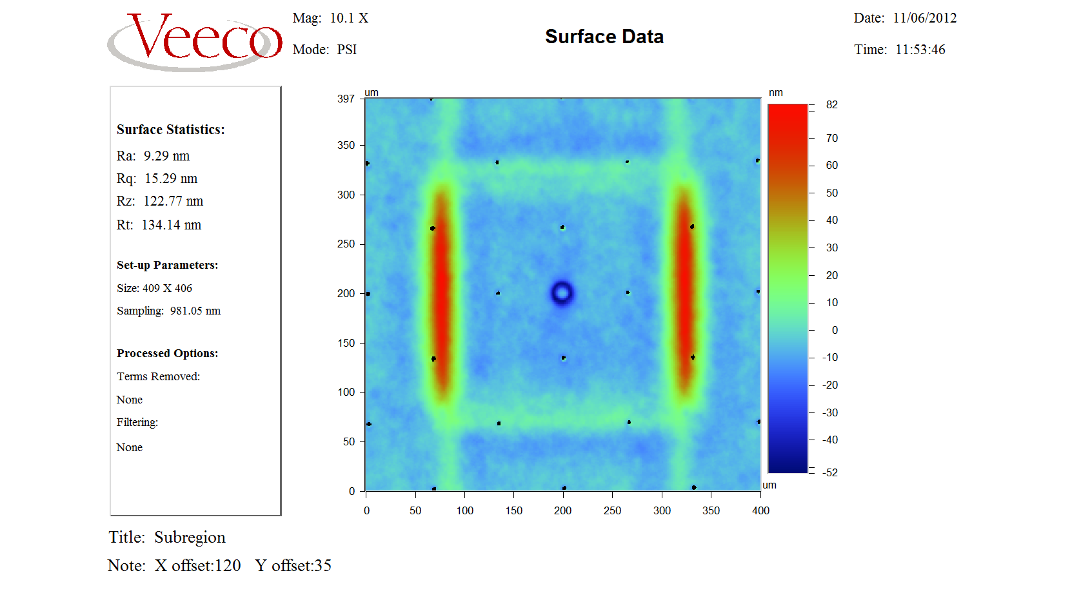
Single Actuator

